Slide 1
Midterm Review

Slide 2
Agenda
Concepts
Chapter 6
Chapter 7
Chapter 8
R Functions and Output
Kahoot

Slide 3
Subset Selection
Best Subset - Fit a separate least squares regression for every possible combination of the p features (total of 2^p models)
Forward - Begin with no features and add one feature at a time (k) until all features (p) are in the model
Backward - Begin with all p features and remove the least useful feature at a time (k) one at a time until no feature remain

Slide 4
Advantages and Disadvantages
 | Best Subset | Forward | Backward
Pros | Easy to Understand Absolute Best Model | Computationally efficient Can be run when n < p | Computationally efficient
Cons | Computationally intense | Final model is not always the best model | Final model is not always the best model Cannot be run when n < p

Slide 5

Shrinkage Methods
Ridge - Shrinks the beta coefficient towards zero (but not zero)
Use when most features in the model are useful
Lasso - Shrinks the beta coefficient towards zero (while allowing zero)
Use when model includes a lot of useless features
Must Choose a Lambda.
Tuning - Trying different lambda values
Use 10-fold cross-validation to pick lambda with lowest variance

Slide 6
Dimension Reduction
Principal Components Regression (PCR) - Unsupervised
Only uses X features to extract components
Partial Least Squares (PLS) - Supervised alternative to PCR
Identify new X features using the response Y
Place highest weight on features most strongly related to Y

Slide 7
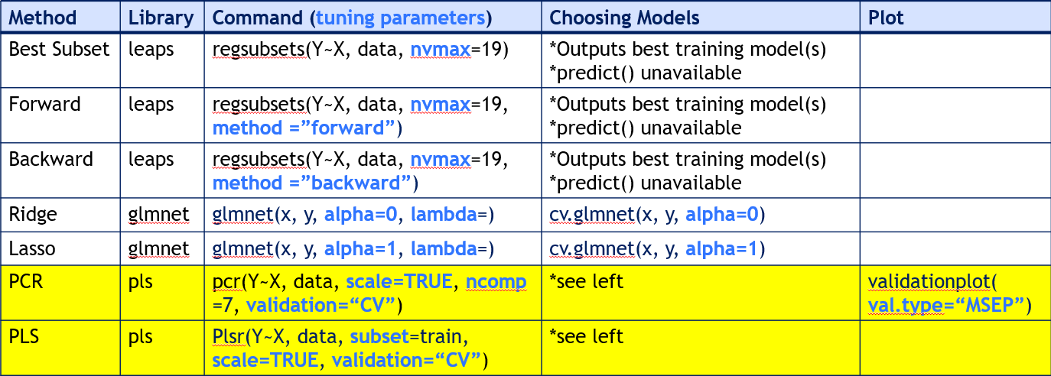
R Commands

Slide 8
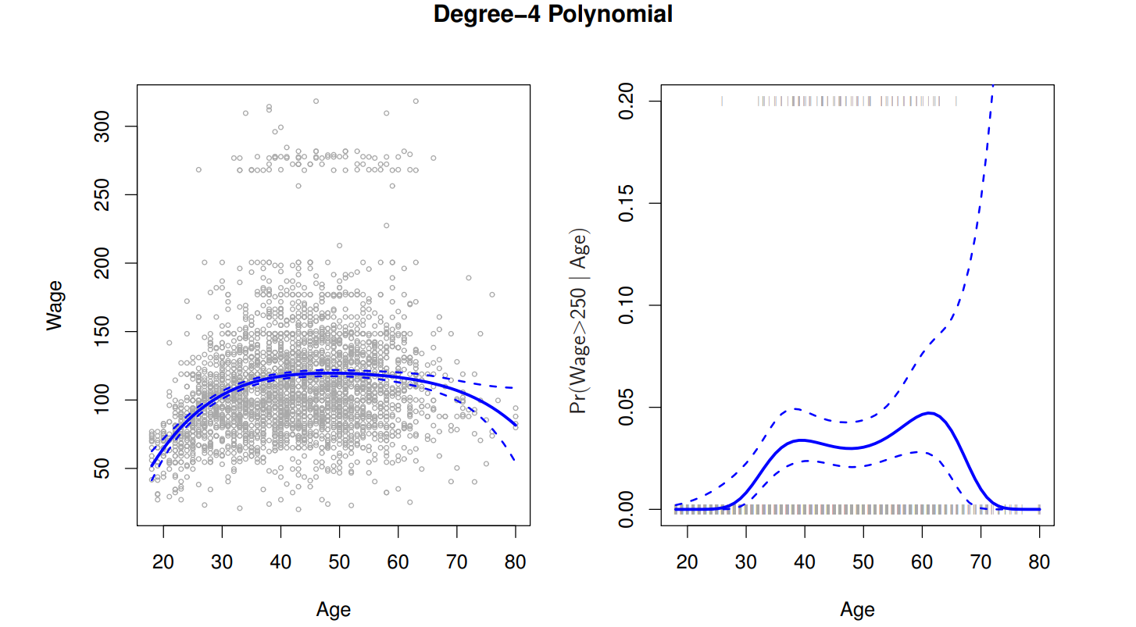
Polynomial Regression
Extends the linear model feature space
Raises predictor variables to a power

Slide 9
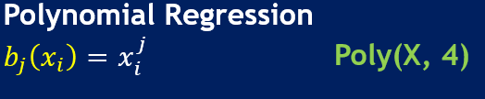
Polynomial Regression
Nonlinear model – increased flexibility of fit
Basis Function

Slide 10
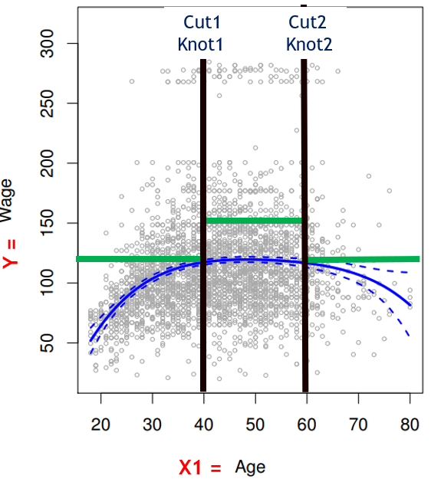
Step Function
Polynomial Regression
Step Function
Cuts feature range into distinct regions

Slide 11

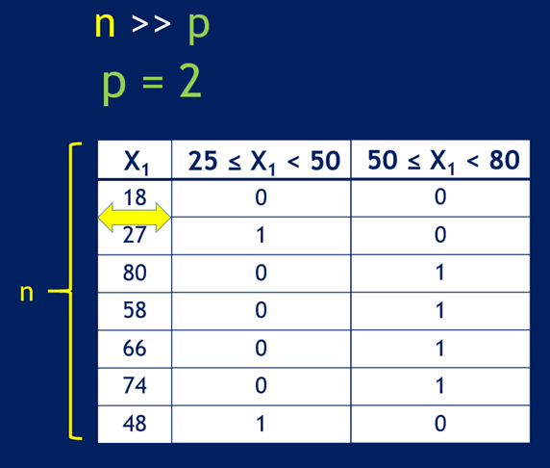
Step Function
Continuous feature X is converted to an ordered categorical feature

Slide 12
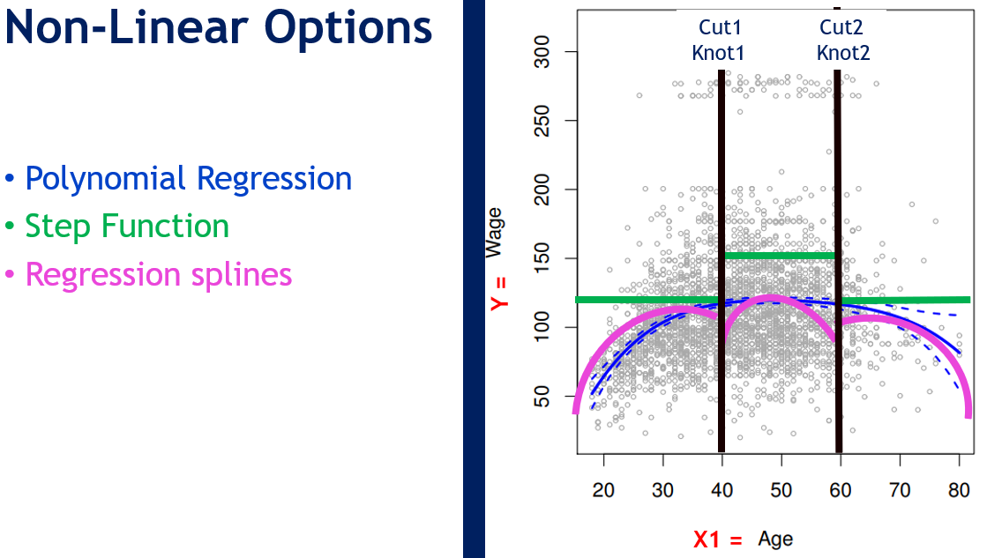
Regression Splines
Splines will generally produce stable estimates
Fits lines and polynomials over different regions of X
Constrained Splines have a fitted continuous line

Slide 13
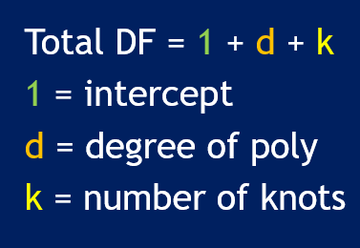
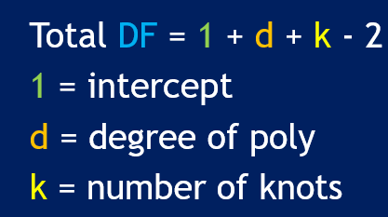
B-Splines vs. Natural Splines
B-Spline = Regression Spline, bs() in R
Natural Spline = Regression Spline for fitting outer ranges of X, ns()
additional boundary constraints and linear functions
improved Confidence Interval
B-Spline DF Natural Spline DF

Slide 14
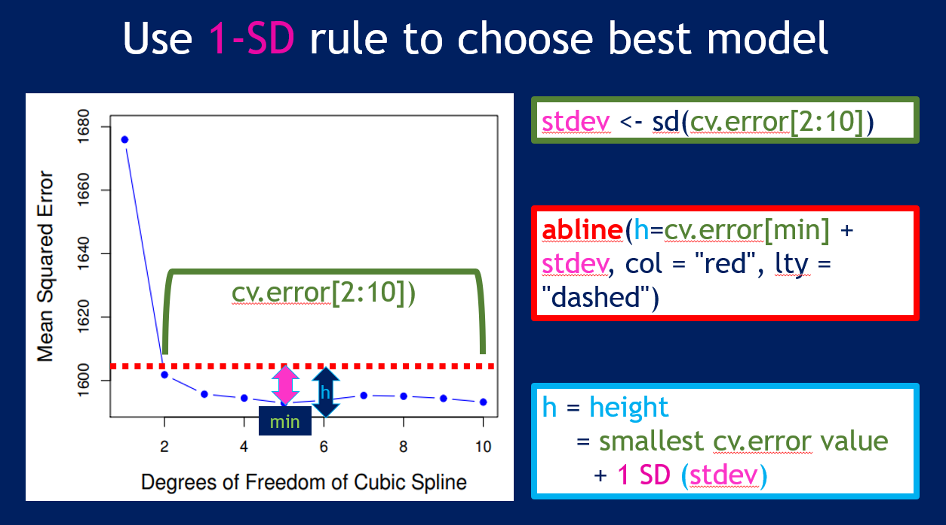
Knots and Model Selection
Determine amount of knots by:
Selecting “df” value based on polynomial factor
Plot the MSE vs a model range of increasing df
Cross-Validation, cv.lm() or cv.glm()

Slide 15
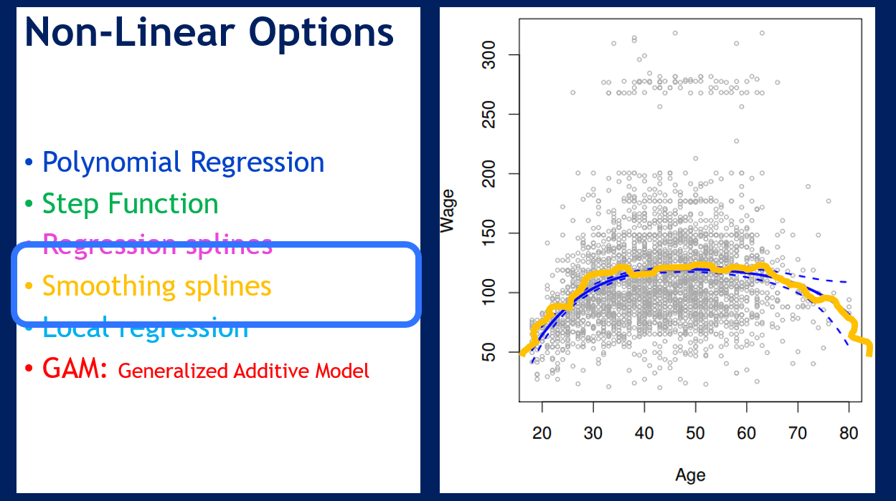
Smoothing Splines
Prevent overfit by “smoothing” a regression spline
smoothness penalty function determines slope at every knot

Slide 16
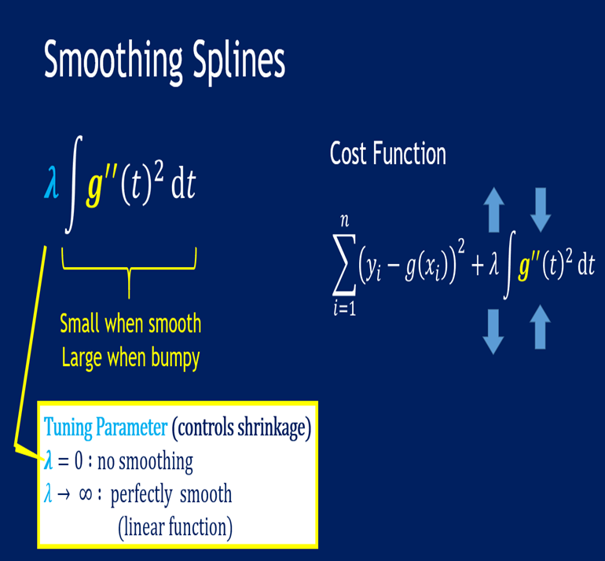
Smoothing Splines: Lambda
Lambda
Tuning parameter of smoothness
Controls effective DF
Select with cross validation

Slide 17
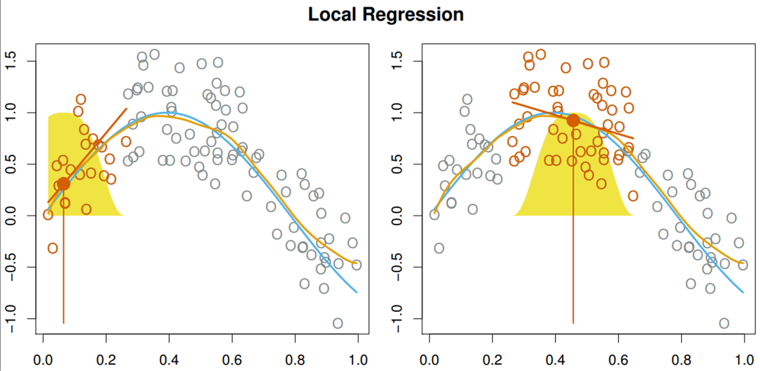
Local Regression
Weighted Least Squares
Idea:
Fit regression models in small localized regions using only nearby data
Weighted Least Squares:
The points closest to the target point should be weighted more, and should contribute more to the slope of the line.
The colored points are used to find the line of best fit in the small region (red line)
Repeating this process for the x axis points gives estimated function in orange

Slide 18
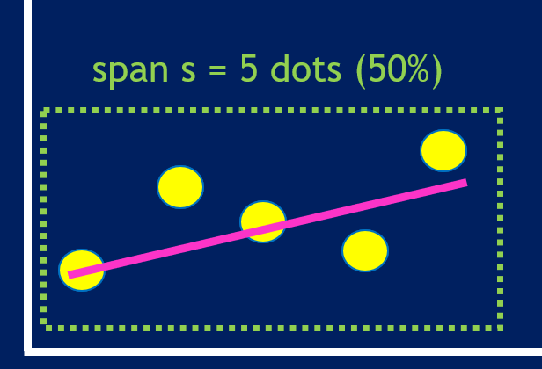
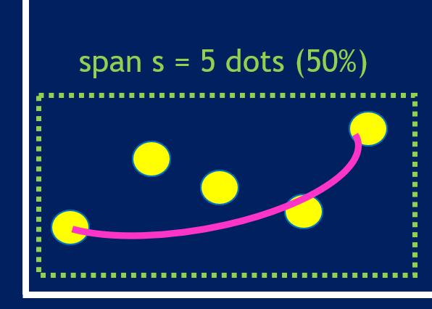
Local Regression: Choices
Weight Function
Type of Model (Degree)
linear regression
n degrees polynomial

Slide 19
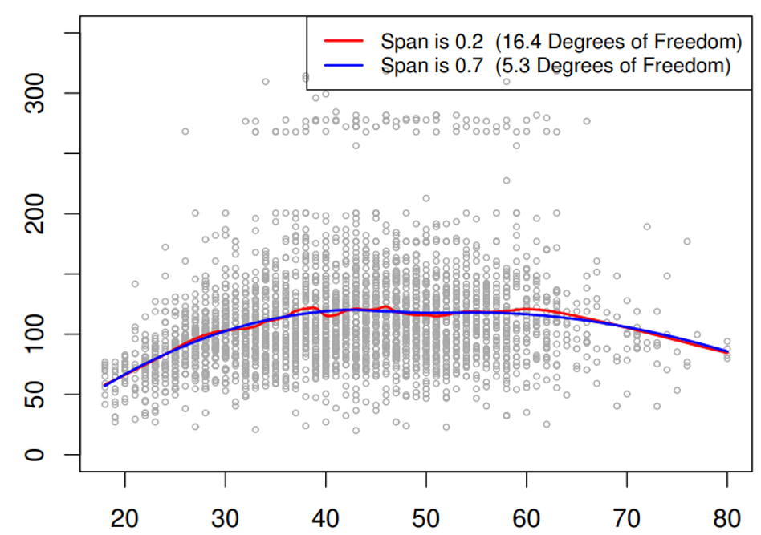
Local Regression: Choices
3. Span Size
Large span ends up with very smooth estimate
Small span makes very noisy estimate

Slide 20
Generalized Additive Models (GAMs)
The previous one focuses on a single predictor at a time
GAMs work with multiple predictors
Idea:
Derived from multi-linear regression model
Replace all the linear terms with arbitrary functions f() (allows non-linear functions)
Maintains additivity
Allows numeric & categorical features

Slide 21
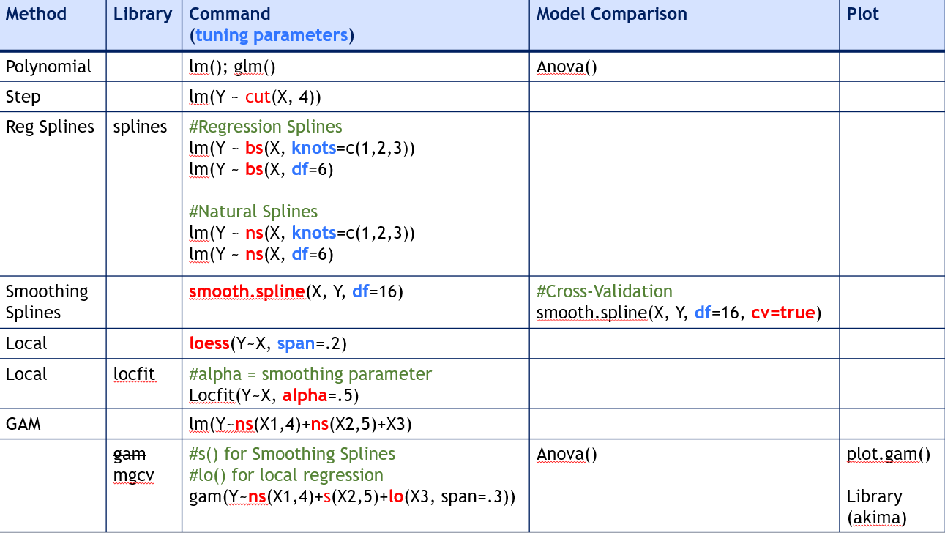
R Commands

Slide 22
Chapter 8: Tree-Based Methods
Decision Tree: A type of supervised model used to categorize or make predictions based on how a previous set of questions were answered
Regression Tree: Leaf nodes are numeric
Classification Tree: Leaf nodes are categorical

Slide 23
Tree: Steps
For each split, individually calculate the purity score of each node
Calculate the purity score of each split as the weighted average purity score of child nodes
Select the split with the best purity score
Repeat until you achieve homogeneous nodes

Slide 24


Tree: Measuring Purity
Gini Impurity
0.5 is maximal inequality, 0 is maximal purity
Entropy
1 is maximal inequality, 0 is maximal purity

Slide 25
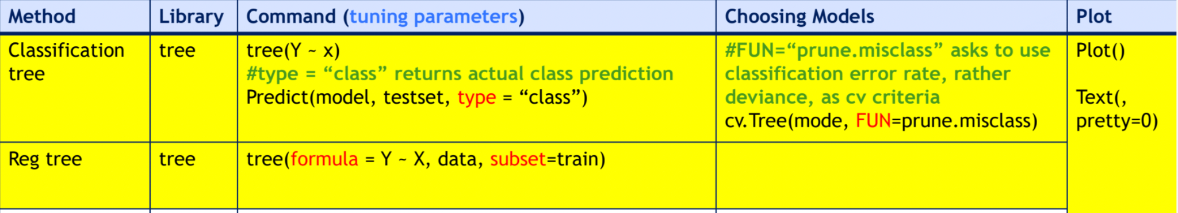
R Commands

Slide 26
Quick R Review

